Slide 1

Group 4
11th August 2025

Slide 2
1. CECILIA ACHEAMPOMAAH DWOMOH - SE/DMD/24/0026
2. ⁠JOSEPH ASARE - SE/DMD/24/0019
3. PRISCILLA BEDZRA - SE/DMD/24/0005
4. RAZAK BABA MOHAMMED - SE/DMD/24/0004

Slide 3


TASK
Open data sources are unlocking unprecedented collaboration, transparency and accountability in the data landscape. Identify some of the global open data sources and demonstrate how to access data from at least two of the several sources

Slide 4
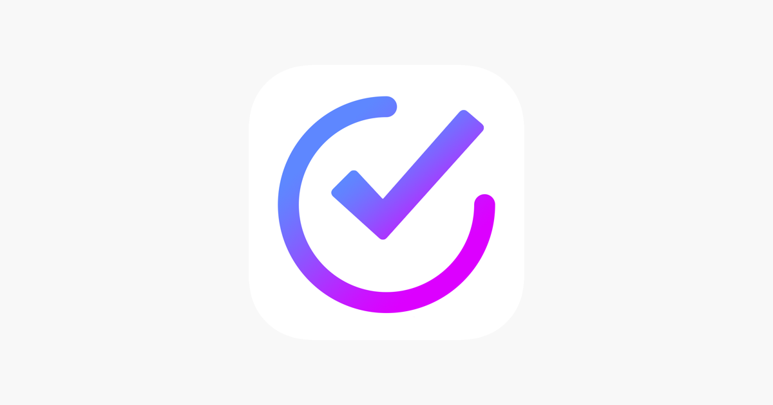
GOAL
To identify Global Open Data Sources and demonstrate access from three key platforms

Slide 5
ORDER OF PRESENTATION
Introduction
Sources of Global Open Data
Why Global Open Data Matters
Three Key Global Open Data Sources
Demonstrating access to the three key Open Data Sources
Conclusion

Slide 6
What is open data Sources?
Open data sources are repositories or platforms where data is made freely available for anyone to use, reuse, and share subject to no or minimal restrictions. It provides a wide range of information covering sectors such as health, education, environment, governance, and economics

Slide 7
Sources of Global Open Data
Source | Provider | Focus Area | Example Data | Website
World Bank Open Data | The World Bank Group | Global Development | GDP, poverty rates, education stats | data.worldbank.org
UN Data | United Nations Statistics Division | UN Statistics | Population, environment, trade | data.un.org
WHO Global Health Observatory | World Health Organization | Health | Life expectancy, health coverage, disease statistics | who.int/data/gho
IMF Data | International Monetary Fund | Economics/Finance | Inflation, exchange rates, fiscal balances | data.imf.org
OECD Data Portal | Organization for Economic Co-operation & Development | Policy/Economy | Taxation, education, inequality, productivity | data.oecd.org

Slide 8


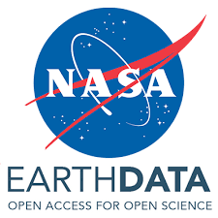


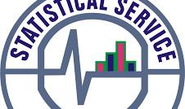
SOURCEs with minimal restrictions
European Union
Food and Agriculture Organization of the United Nations (FAO)
Google Cloud Public Dataset
World Pop
NASA Earthdata
Ghana Statistical Service

Slide 9

Why GLOBAL Open Data Matters
Collaboration : Enables shared research and innovation across borders
Transparency : Provides public insight into global issues like economics and health
Innovation : Fuels new research, apps, and solutions
Evidence-Based Decisions : Supports policy-making with facts
Accountability : Allows tracking of progress (e.g., SDGs) and holding entities responsible

Slide 10



THREE KEY OPEN DATA SOURCES
The data from these three organizations is presented in internationally recognized formats and classifications. Their datasets are widely used, reliable, and trusted by policymakers, researchers, and institutions worldwide
The World Bank Group
United Nations
World Health Organisation

Slide 11
Demonstrating access to the three key Open Data Sources

Slide 12
ACCESS TO World Bank Open Data
Website: https://data.worldbank.org
Locate Data & Resources
Search for indicators (e.g., GDP per capita) or browse by topic/country/economy/indicator
Download datasets (CSV, Excel, Wide Format, JSON)

Slide 13
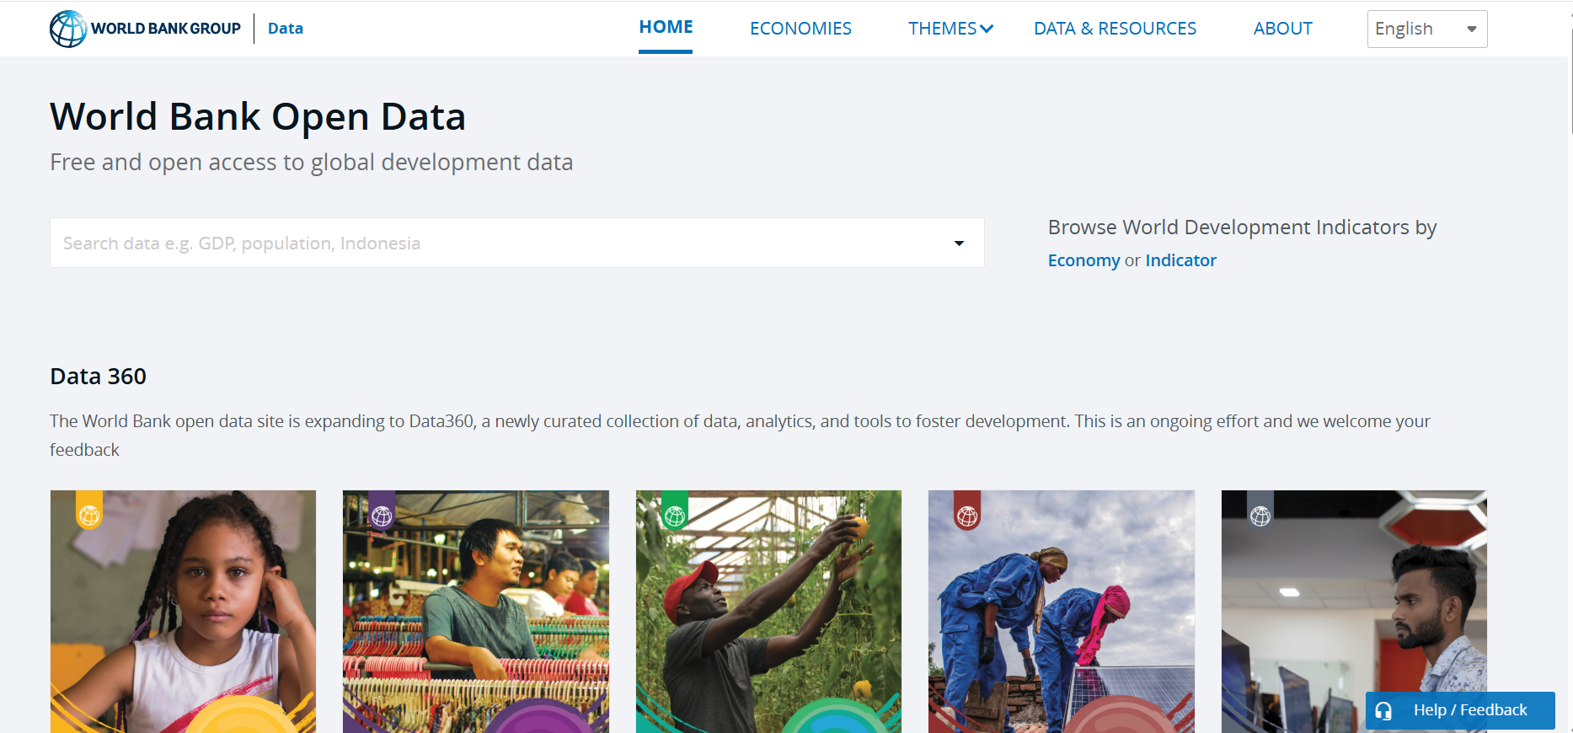

Slide 14
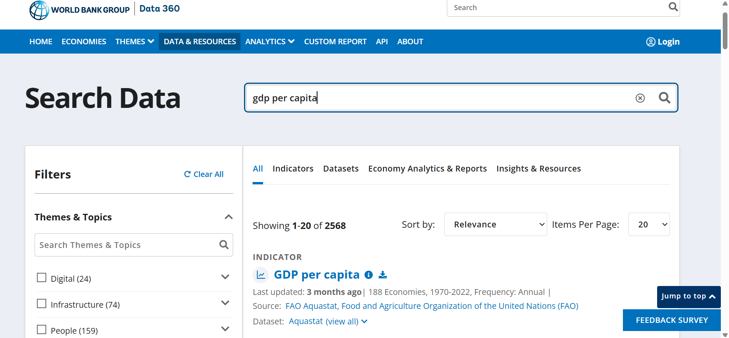

Slide 15
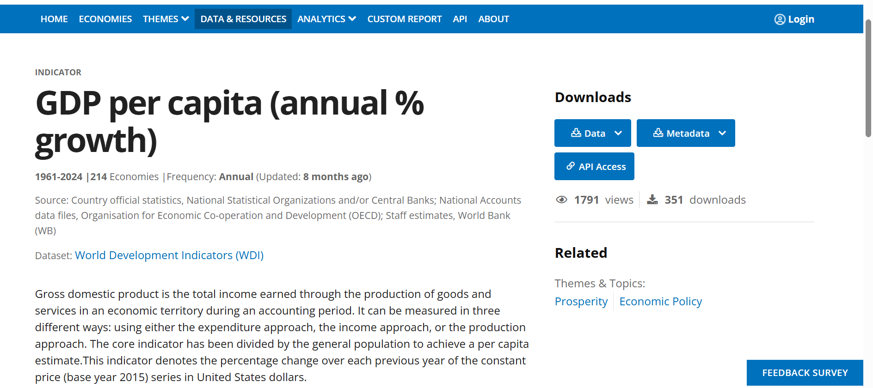

Slide 16
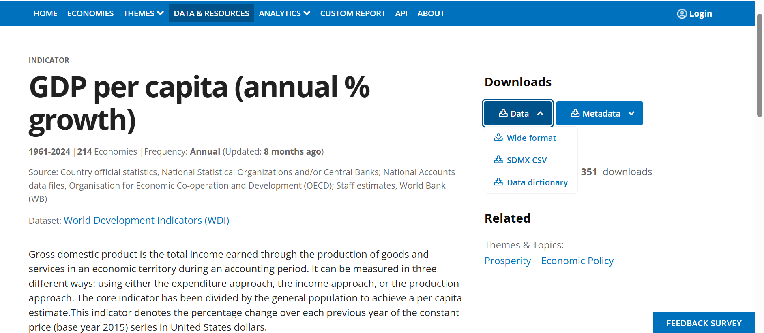

Slide 17
ACCESS TO United Nations Open Data
Website: https://data.un.org
Search/Browse a data theme (population, trade, environment)
Browse the filter to select country/year
Download datasets in , XML, CSV or Excel

Slide 18
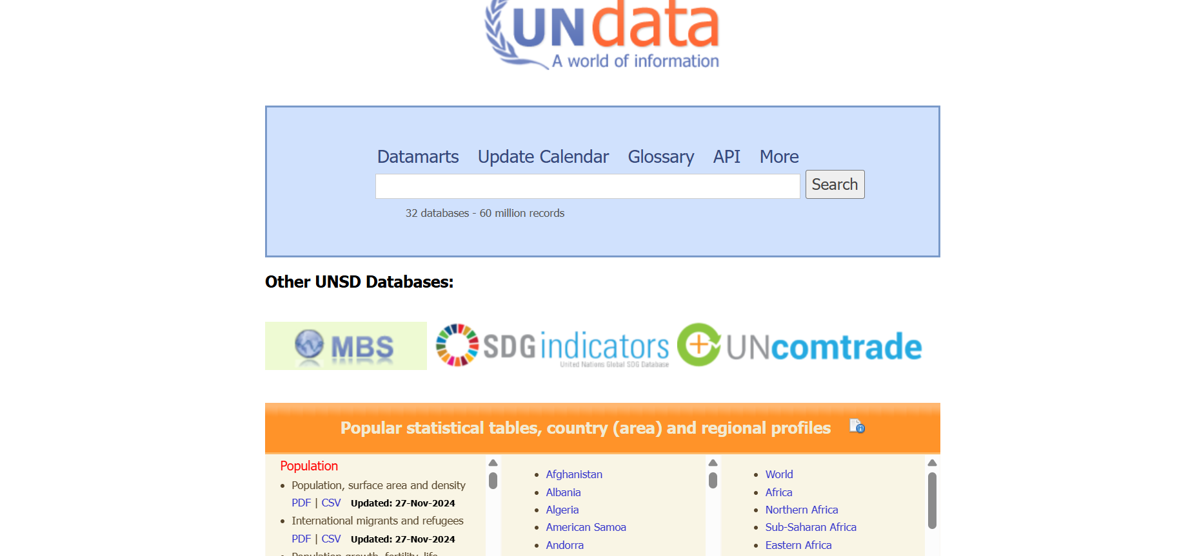

Slide 19
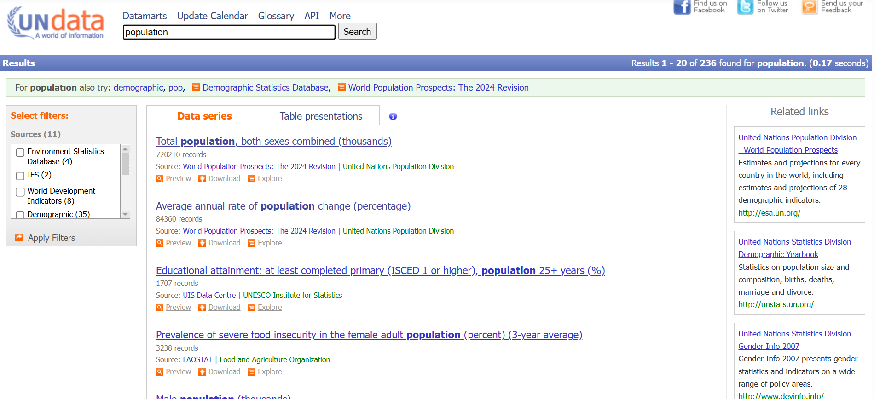

Slide 20
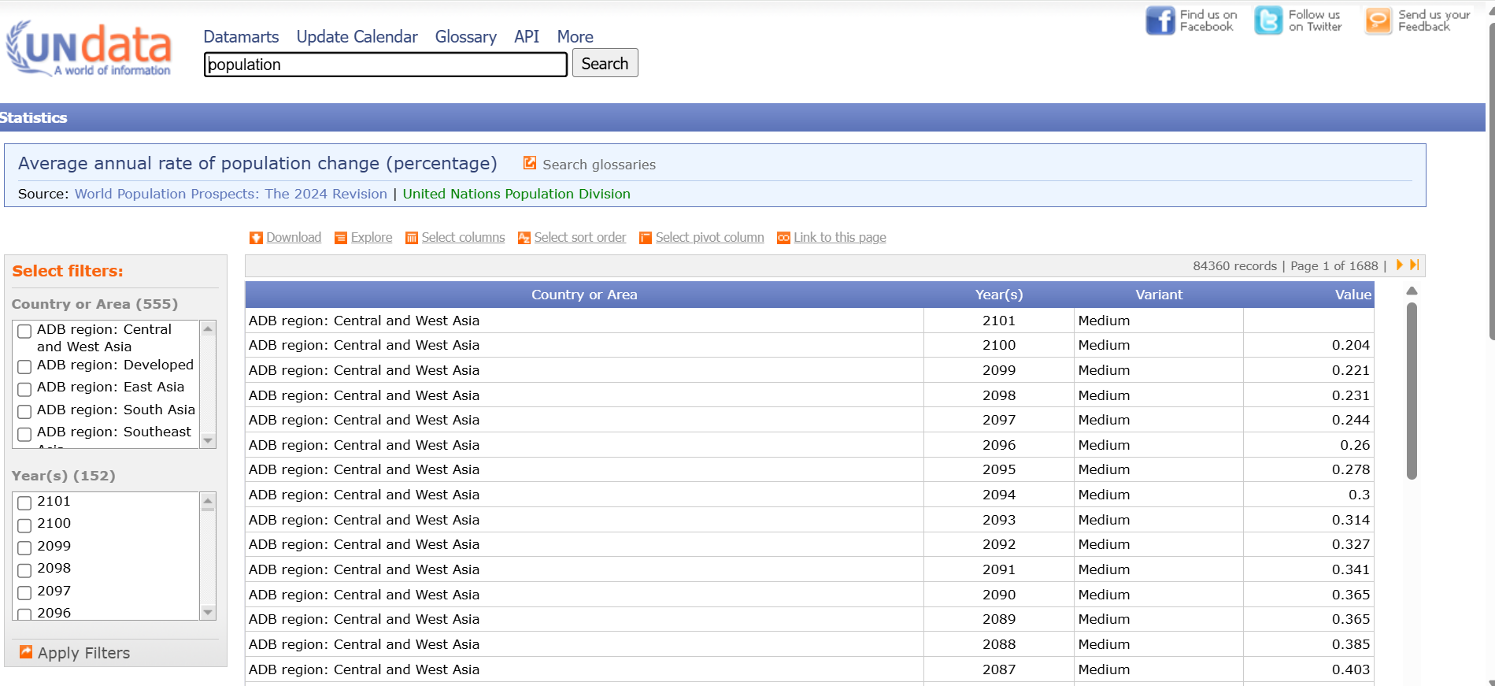

Slide 21
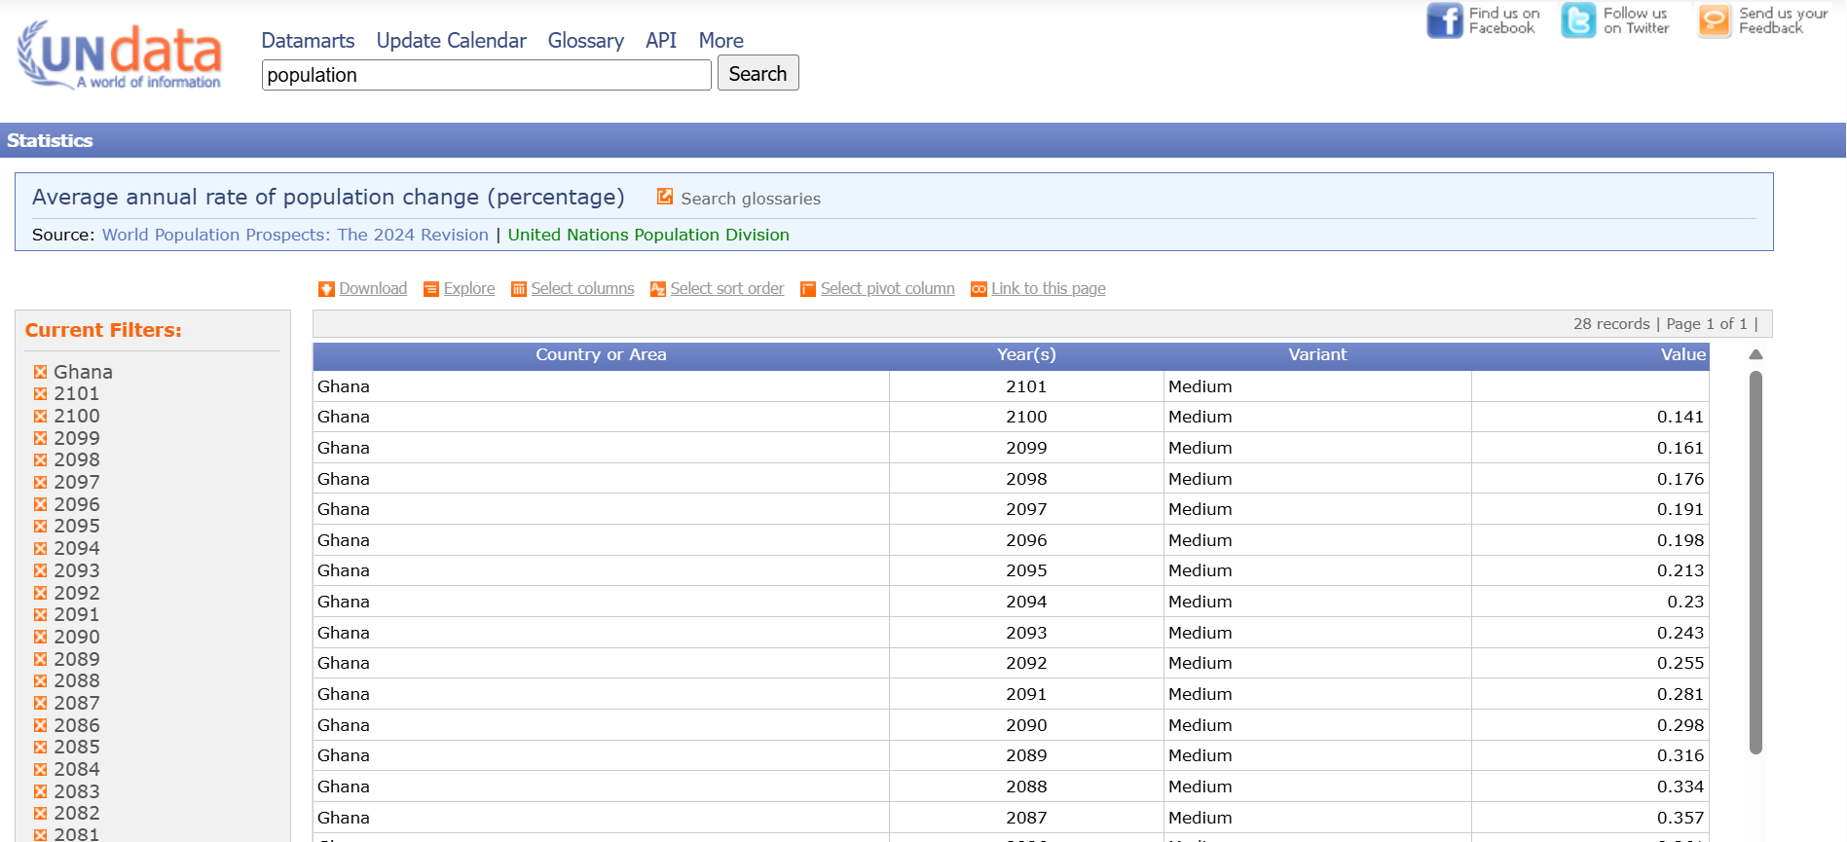

Slide 22
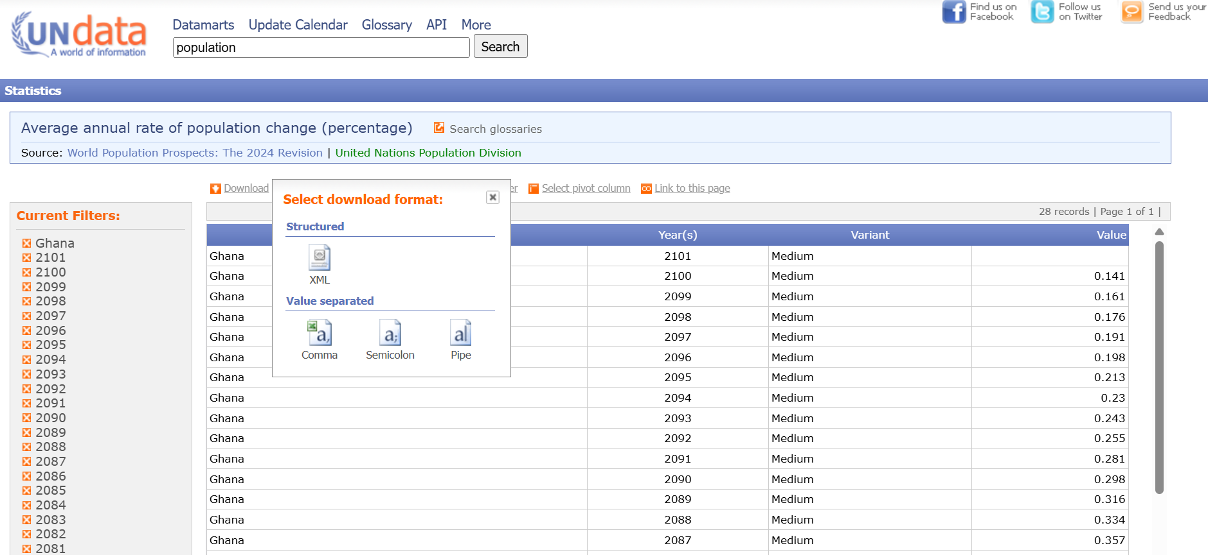

Slide 23
ACCESS TO WHO Global Health Observatory
Website: https://www.who.int/data/gho
Search/browse by topic or indicators (e.g., Life expectancy, communicable diseases)
Browse the filter to select country/year
Download CSV, Excel, or visualize online

Slide 24
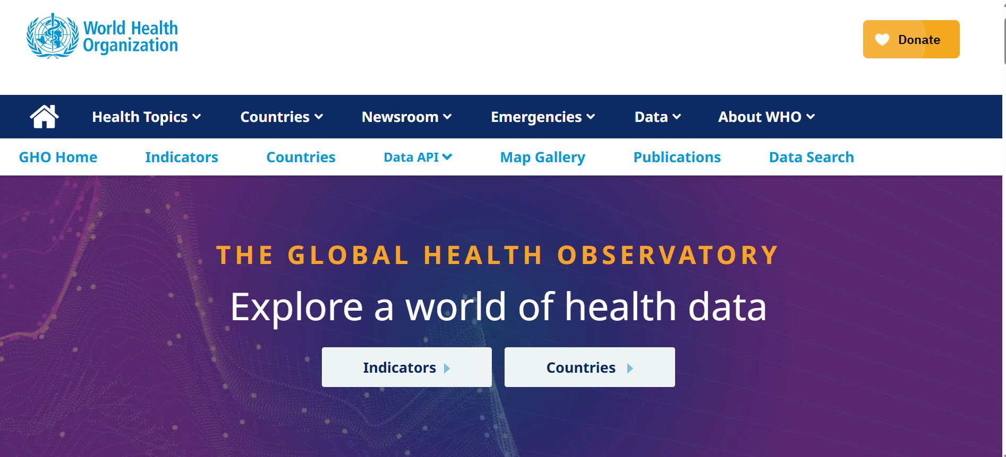

Slide 25
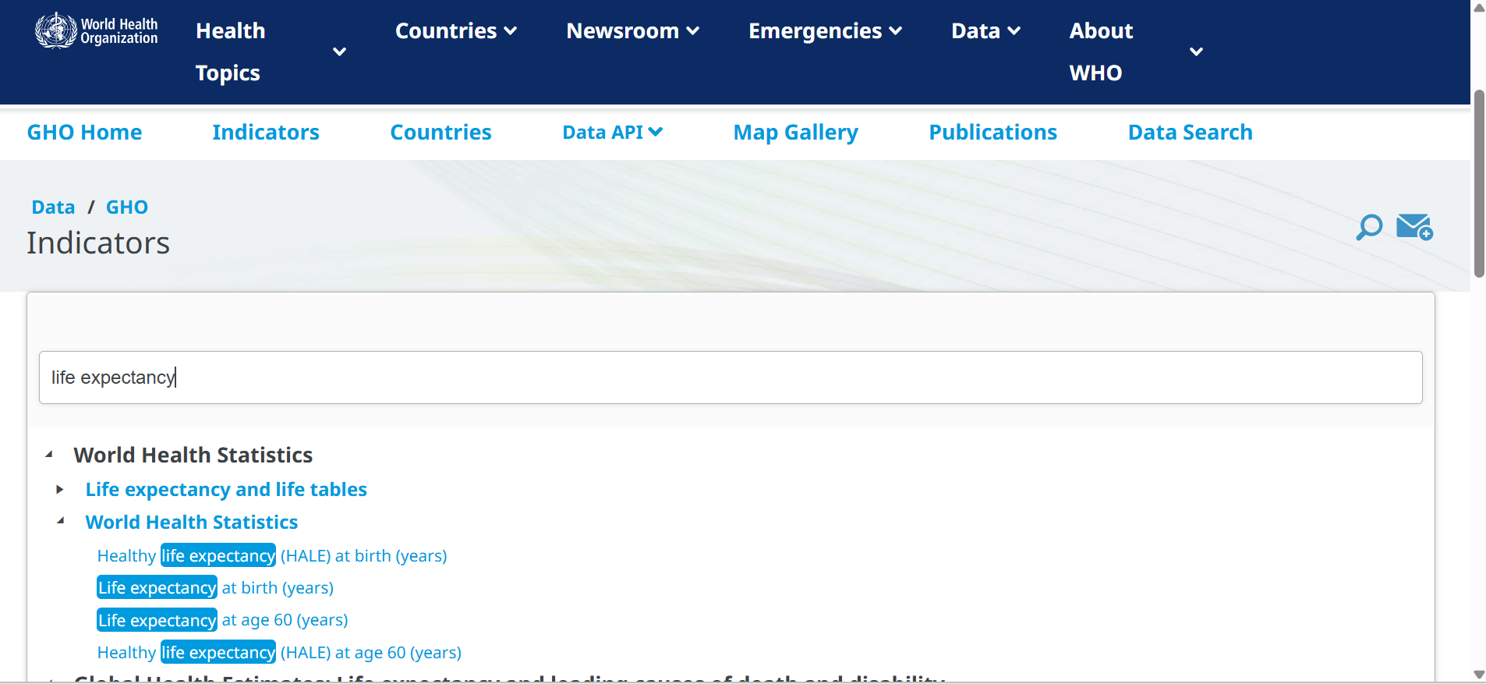

Slide 26
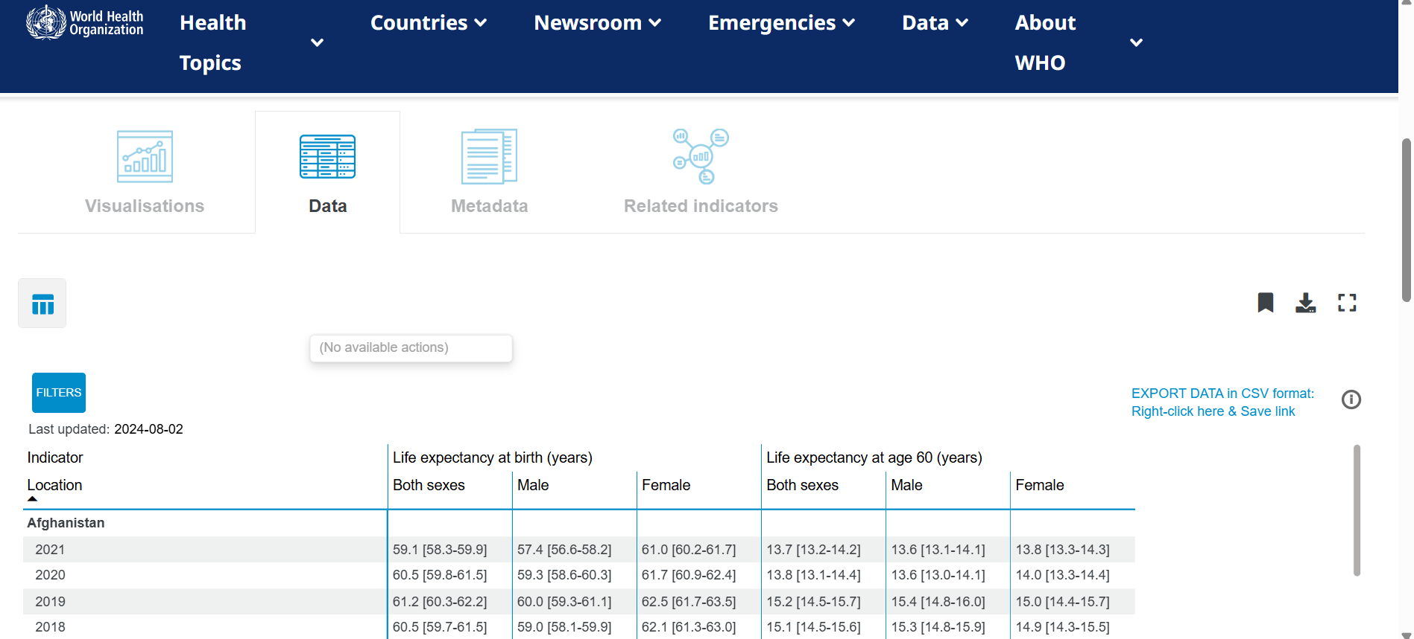

Slide 27
Risks of Global Open DatA Sources
Privacy and Confidentiality Breaches
Even when data is anonymized, advances in data analytics and cross-referencing with other datasets can lead to re-identification of individuals. This can expose sensitive personal information, such as health records, income levels, or political affiliations
Misinterpretation and Misuse of Data
Open datasets can be misinterpreted by non-experts, leading to flawed conclusions, misinformation, or policy errors. In extreme cases, data can be intentionally manipulated to support biased narratives
Accessibility and Usability
Not all open datasets undergo rigorous quality control. Outdated, incomplete, or inaccurate data can compromise research validity and lead to misguided decisions
Cybersecurity and Data Integrity Risks
Open data platforms may become targets for cyberattacks, data manipulation, or corruption of files, potentially undermining trust in the dataset
Metadata and Documentation Standards
Publish datasets with comprehensive metadata that explains methodology, scope, limitations, and intended uses to reduce misinterpretation
Economic and Strategic Risks
In sensitive sectors such as defense, energy, or natural resources, making certain datasets openly available could inadvertently reveal strategic vulnerabilities or be exploited by malicious actors

Slide 28
BEST PRACTICES
The World Bank Group | Economic Data Risk Assessment – Check for trade or market vulnerability exposure to safeguard economic stability Transparency with Methodology – Publish full notes with datasets to reduce misinterpretation by non-experts Licensing Clarity – Use standard open licenses with attribution to avoid intellectual property disputes Quality Control for Indicators – Automated checks and reviews to ensure reliability of economic metrics Secure Access for Strategic Data – Share sensitive financial models under confidentiality to protect national economic security
United Nations | Ethical & Inclusive Data Governance – Apply human rights and cultural sensitivity filters to Prevent harm in politically or socially sensitive contexts Comprehensive Metadata – Link datasets to SDGs and explain limitations to promote accurate SDG tracking. Tiered Access – Restrict conflict-zone or humanitarian data to protect vulnerable populations. Anti-Misinformation Safeguards – Fact-checking partnerships to counter misuse of UN data
World Health Organization | Privacy-First Health Data Governance – Apply advanced anonymization and remove granular identifiers Protect patient confidentiality in global health datasets. Standardized Health Data Documentation – Use ICD codes and detailed metadata to ensure consistency and clarity in health statistics Data Quality Assurance – Peer review and timely updates to maintain epidemiological integrity. Controlled Access – Secure portals for outbreak or sensitive health data to prevent misuse of high-risk datasets Global Health Data Literacy – Training for health ministries to avoid misinterpretation in public health responses.

Slide 29
CONCLUSION
Open data sources make it easier for everyone, including governments, researchers, and the public, to access and use valuable information. They promote transparency, build trust, improve decision-making, and encourage collaboration across the world.
However, the associated risks particularly around privacy, quality, and misuse mean that robust governance, technical safeguards, and ethical considerations must guide its release. A balanced approach, where openness is coupled with protection, ensures that open data can serve the global good without compromising security or individual rights

Slide 30

QUESTIONS?

Slide 31
REFRENCES
World Bank. (n.d.). World Bank Open Data. https://data.worldbank.org
United Nations Statistics Division. (n.d.). UNdata. https://data.un.org
World Health Organization. (n.d.). Global Health Observatory (GHO)
data. https://www.who.int/data/gho
International Monetary Fund. (n.d.). IMF Data. https://data.imf.org
Organisation for Economic Co-operation and Development. (n.d.). OECD Data. https://data.oecd.org

Slide 32
THANK YOU

